Slide 1
Tourism
AJANTA CAVES
By: Ananya Singh

Slide 2

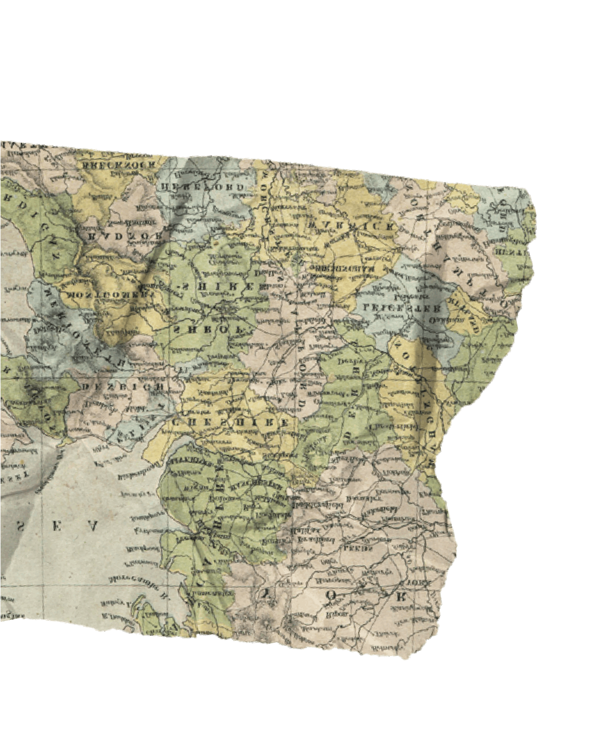

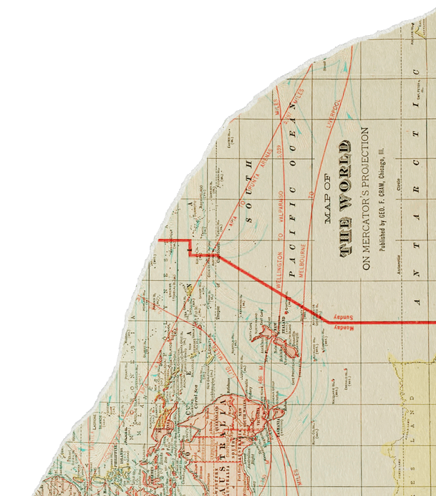
d
introduction
History of the caves
Index
01.
Distance and Route
cultural significance
facts
.
conclusion

Slide 3
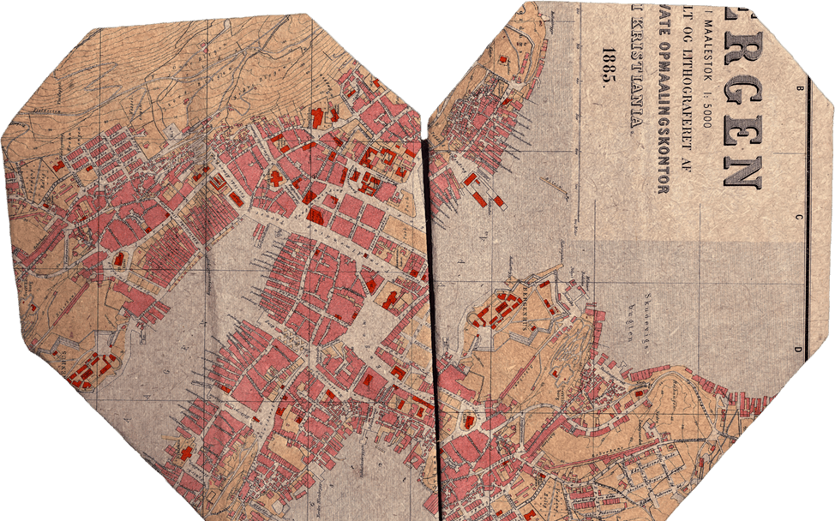
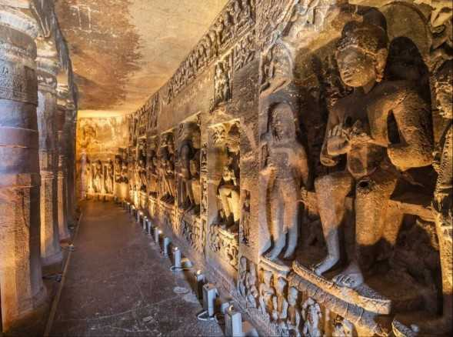
Introduction
Location: Maharashtra, carved into a horseshoe-shaped cliff along the Waghora River.
Structure: Comprises 30 rock-cut Buddhist caves.
Dynasties: Constructed under the Satavahana and Vakataka dynasties.
Time Period: Built in two phases (2nd century BCE–6th century CE).
Types of Caves:
Chaityas – prayer halls
Viharas – monasteries
Artistic Significance: Renowned for wall paintings and frescoes with lifelike expressions and vivid colors.
Rediscovery: Rediscovered in 1819.

Slide 4
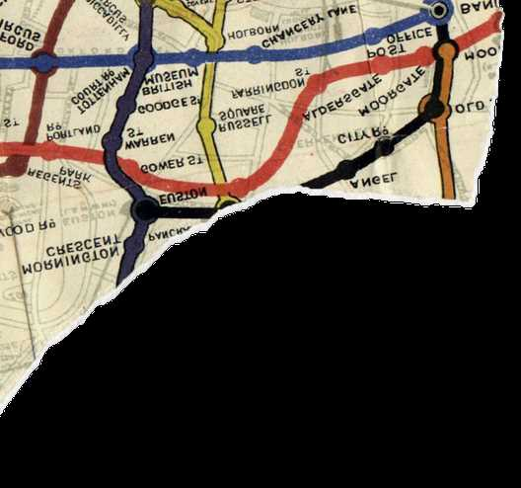
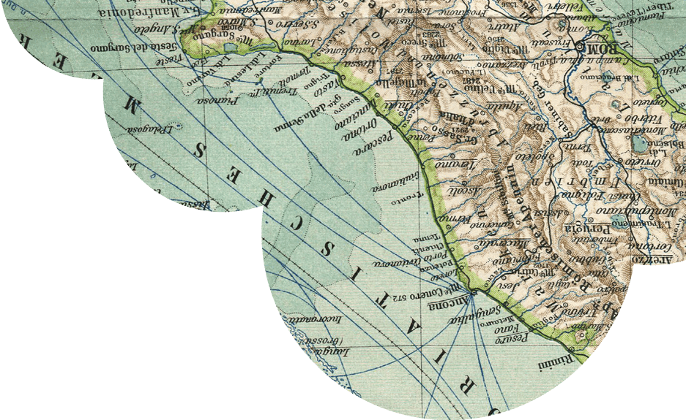


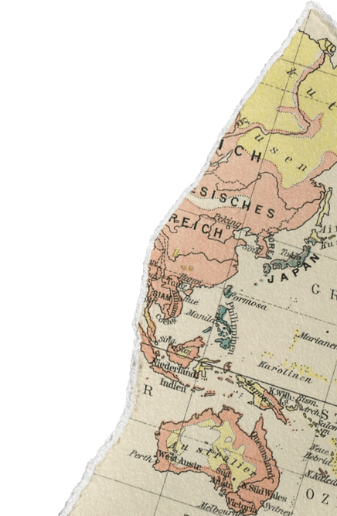
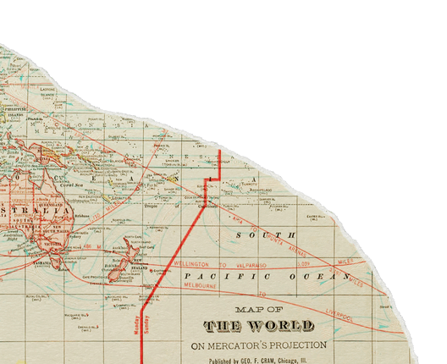
. History of the Caves
Ajanta Caves were built in two phases.
First phase (2nd century BCE):
-Simple caves for meditation and monastic life
-Followed Hinayana Buddhism
-Under Satavahana rulers
Second phase (5th–6th century CE):
-Under the Vakataka dynasty, especially King Harishena
-Influence of Mahayana Buddhism
-Images of Buddha, Bodhisattvas, and narrative paintings
-After decline of royal support, caves were abandoned.
.

Slide 5

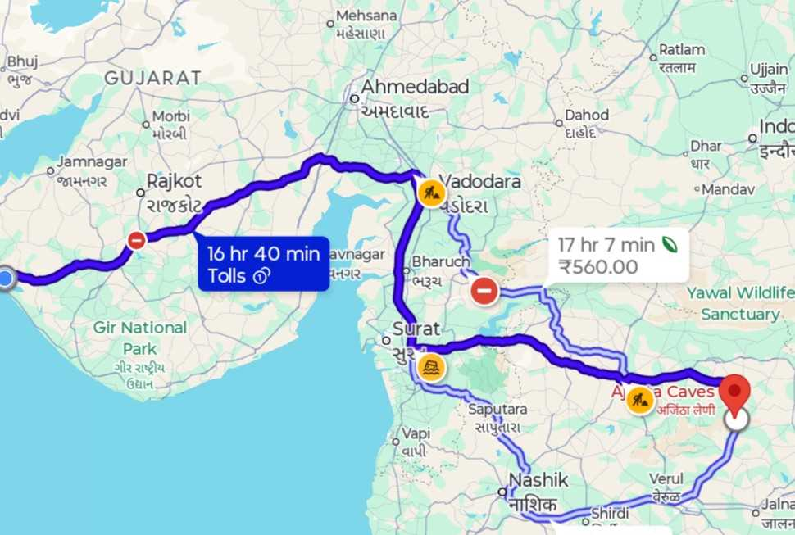
Distance and Route
The Ajanta and Ellora Caves are located near Aurangabad in Maharashtra, roughly 750-800 km east of Porbandar, Gujarat, a journey typically taking 14-16 hours by road via NH48 or NH52. Ellora Caves (6th-10th century) are 30 km from Aurangabad, while Ajanta Caves (2nd century BC) are 100 km north of the cit . . i-. :
Ajanta and Ellora Caves are located near Aurangabad, Maharashtra.
They are about 750–800 km east of Porbandar, Gujarat.
Road travel takes approximately 14–16 hours via NH48 or NH52.
Ellora Caves: About 30 km from Aurangabad (6th–10th century CE).
Ajanta Caves: About 100 km north of Aurangabad (2nd century BCE).

Slide 6
Cultural importance
Educational: Ajanta Caves help students and researchers study ancient Indian history, Buddhist culture, art, and rock-cut architecture.
Cultural: They preserve and showcase India’s rich artistic and spiritual heritage, promoting cultural awareness and identity.
Tourism: As a UNESCO World Heritage Site, Ajanta attracts national and international tourists, supporting heritage tourism and local economy.

Slide 7
01.
The paintings depict the life of Lord Buddha and Jataka tales.
Facts Of Ajanta Caves
02.
03.
Ajanta represents both Hinayana and Mahayana Buddhism.
The caves were rediscovered in 1819 by a British officer named John Smith.

Slide 8
Conclusion
.
Ajanta Caves showcase ancient Indian art, architecture, and Buddhist heritage.
The murals depict the life of Lord Buddha and cultural life of the time.
They provide insight into India’s historical and spiritual traditions.
As a UNESCO World Heritage Site, they preserve India’s cultural legacy.

Slide 9
Thankyou!!

